Slide 1
BRITISH AIRWAYS PREDICT CUSTOMER BEHAVIOUR
Tam Nguyen
November 27, 2022

Slide 2
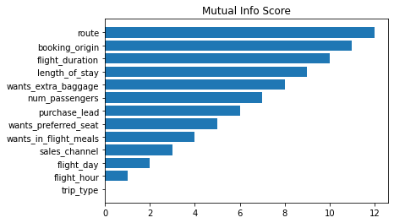
RESULT ANALYSIS
I applied the RandomForest Algorithm for the provided dataset and get the following result:
5 factors below highly affects the customer buying behaviour:
Route
Booking origin
Flight duration
Length of stay
Extra baggage
I also got the Accuracy of 83.26,
AUC Score of 0.5554167016137819
Should improve more on both Accuracy and AUC Score

